Slide 1
SCHOOL QUIZ
Questions

Slide 2
1
India: online teaching doesn’t work. Only 24% of the Indian citizens have a smartphone.
In Utarrakhand and Chhattisgarhthey an offline solution was developed to keep parents informed of their children’s school performance. Which tool was developed?

Slide 3
1 In India an offline solution was developed to keep parents informed of their children’s school performance. Which tool was developed?
Parents were instructed by the government
how to teach their own children.
B. Parents could call a free number and receive voice messages.
C. The government provided smartphones
for the parents.
D. Parents were requested to log into public hotspots
so they could get information about the courses.

Slide 4
2
Mexico: according to official data only 56,4% of the Mexican households have access to internet. Only 44,3% have access to a computer.
How could learners get lessons in Mexico?

Slide 5
2 How could learners get lessons in Mexico?
A. Lessons on TV and radio.
B. Lessons in a daily newspaper.
C. Teachers distributed course copies to the learners.
D. The government set up public hotspots with free Wi-Fi.

Slide 6
3
Children can get a free or cheap meal in a lot of schools.
Often it is the only food they can get during the day.
How many children are missing these school meals as a result of closing the schools?

Slide 7
3 How many children are missing these school meals as a result of closing the schools?
A. 700 0000
B. 75 million (75.000.000)
C. 258 million (258.000.000)
D. 370 million (370.000.000)

Slide 8
4
Teachers also have to deal with the emotional well-being of their students.
But this aspect is missing from an online learning system, and the student’s emotional problems go unnoticed.
What was the solution that a belgian teacher came up with, when he noticed that a learner had emotional problems and online help was impossible?

Slide 9
4 What was the solution that a belgian teacher came up with, when he noticed that a learner had emotional problems and online help was impossible?
A. He sent a surprise box to the learner.
B. He went for a walk with the learner
C. He had a telephone call with the learner
D. He arranged a meeting at the supermarket, at a safe place with 1,5 m distance.

Slide 10
5
Which device did nine year old Stephen Wamukota from Kenia invent?
He received a reward from the president of Kenia.

Slide 11
5 Which device did nine year old Stephen Wamukota
from Kenia invent?
A. A mouth mask
B. An open-air classroom
C. A hand washer
D. A multifunctional stick of 1,5 m length

Slide 12
6
Hong Feng, a school principal in Hangzhou in China, found a solution to keep the learners at a safe distance from each other. What did he do?

Slide 13
6 A solution to keep the learners at a safe distance from each other.
Learners wear a cap with wings measuring the social distance.
B. Each learner sits in a small tent in the classroom.
C. Each learner has a little beeper that goes off when someone is coming too close.
D. The courses are organized outside in a large open space. The learners each have
their own space of 4 by 4 meters.

Slide 14
7
How does a teacher in Jammu and Kashmir (India) teach his courses in a coronaproof way?

Slide 15
7 How does a teacher in Jammu and Kashmir (India) teach his courses in a coronaproof way?
He teaches in open air.
When it rains the lessons are canceled.
B. He walks around in town with a speaker/ soundsystem.
C. He recorded a show that is programmed on TV.
D. Every day, he sends SMS-messages with short lessons.

Slide 16
8
Peru has 30 million inhabitants.
Only 30% have a stable internet connection.
And there is no electricity in the countryside.
Students can’t watch lessons broadcast on radio and TV.
A small village in the mountains has no electricity. Many of the parents are illiterate and can’t help their children at home. What solution did teacher Walter Velasquez come up with?

Slide 17
8 A small village in the mountains has no electricity. Many of the parents are illiterate and can’t help their children at home.
What solution did teacher Walter Velasquez come up with?
He developed an educational game that can be played
on every square in every village.
B. He created a teaching robot that can be transported by mule to the smallest villages.
C. He established a teaching chain system allowing children to teach each other.
D. He sent a request to the Ministry of Education to obtain an exceptional license to teach with full protective gear against the virus.

Slide 18
SCHOOL QUIZ
Answers

Slide 19
1 In India an offline solution was developed to keep parents informed of their children’s school performance. Which tool was developed?
B. Parents could call a free number and receive voice messages.
64% of the citizens have a mobile phone. Voices messages are a solution to inform parents.

Slide 20
2 How could learners get lessons in Mexico?
A. Lessons on TV and radio.
Almost 95% of the Mexican households have a television. Education via TV programs is obligated.

Slide 21
3 How many children are missing these school meals as a result of closing the schools?
D. 370 million (370.000.000)
According to the United Nations 370 million children will not have enough food by closing the schools.

Slide 22
4 What was the solution that a belgian teacher came up with, when he noticed that a learner had emotional problems and online help was impossible?
B. He went for a walk with the learner

Slide 23
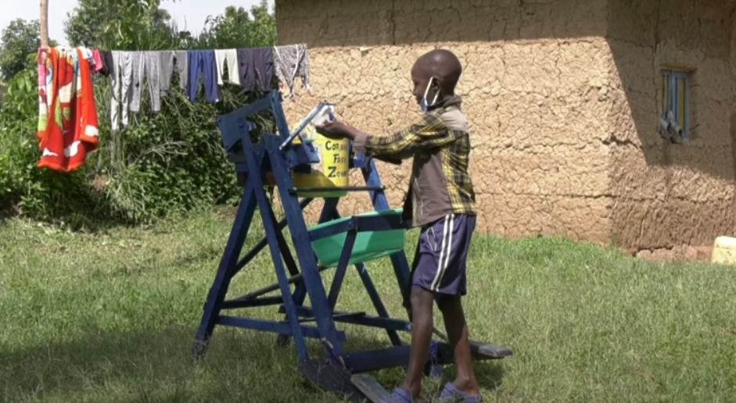
5 Which device did nine year old Stephen Wamukota
from Kenia invent?
C. A hand washer

Slide 24
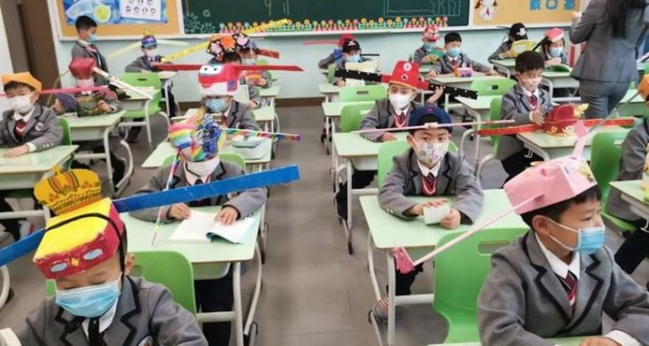
6 A solution to keep the learners at a safe distance from each other.
A. Learners wear a cap with wings measuring the social distance.
The inspiration came from the Song-dynastie (960-1279).
Emperor Taizu obliged a wide hat to avoid whispering about him.

Slide 25
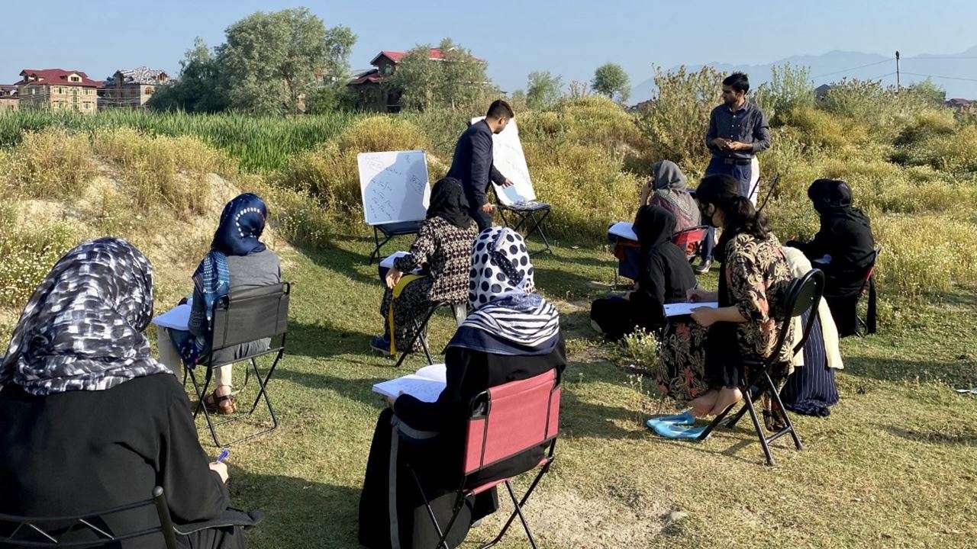
7 How does a teacher in Jammu and Kashmir (India) teach his courses in a coronaproof way?
A. He teaches in open air.
When it rains the lessons are canceled.

Slide 26
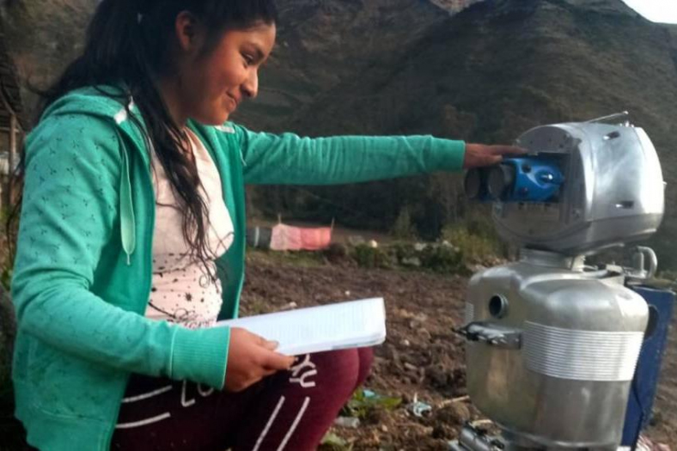
8 A small village in the mountains has no electricity. Many of the parents are illiterate and can’t help their children at home.
What solution did teacher Walter Velasquez come up with?
B. He created a teaching robot that can be transported
by mule to the smallest villages.

